Slide 1

Demonstration of governance structure and client care organization
1
Engagement Governance & Steering Committee
Engagement Governance & Steering Committee
Integrated Program Delivery
Integrated Program Delivery
Production Support Services
Demand Management
Support Entry Framework
Strategic Development Services
Automated Monitoring (L0)
Support Entry Framework
Automated Monitoring (L0)
New Projects (Invest)
L1 Help Desk
Discover & Core Platform
L1 Help Desk
Service Management Office
L1.5
Service Management Office
System Migration (Migrate)
Dep 1
Dep 2
Dep 3
Dep 4
Dep ..N
Change Approval Board
Change Approval Board
Transition Office
Transition Office
Induction Framework
Lilly
Dep 1
Dep 2
Dep 3
Dep 4
Induction Framework
Program Management
L2 & L3
L2 & L3
L2 & L3
L2 & L3
Governance
Major Enhancements (Tolerate)
Governance
SLA Adherence
System Retirement (Eliminate)
Common Services
SLA Adherence
L2 & L3
YASH
Reporting
Cloud Adaption
Data Mgmt./ Gov
Reporting
L2 & L3
Internal Change Management
Metrics & KPI’s
Internal Change Management
Systems Teams (DevOps/CICD/ProdOps)
Support Services
Maintenance Services
Enhancement Services
Metrics & KPI’s
Multi Vendor Service Integration
YASH + Lilly
Multi Vendor Service Integration
Operational Level Agreements
Workflow & Escalation
RACI
Reporting & Communication
Conflict Resolution Process
Operational Level Agreements
Workflow & Escalation
RACI
Reporting & Communication
Conflict Resolution Process
Agile CoE
DevOps CoE
OCM
Technology CoE(s)
Transformation Office
Enterprise Architect
Transformation Office
Engineering Manager
Agile Coach
Domain SME
Operational Transformation
Service Transformation
Legends
Strategic Hiring
Lilly Academy
Lilly Resource Pool
Personal Development Program
Tools and Accelerators
Business Awareness
Knowledge Hub
Tools and Accelerators
S&N Academy
Integrated Support Hub
Delivery
Enablers and BOTs
360 degree Delivery Insights

Slide 2
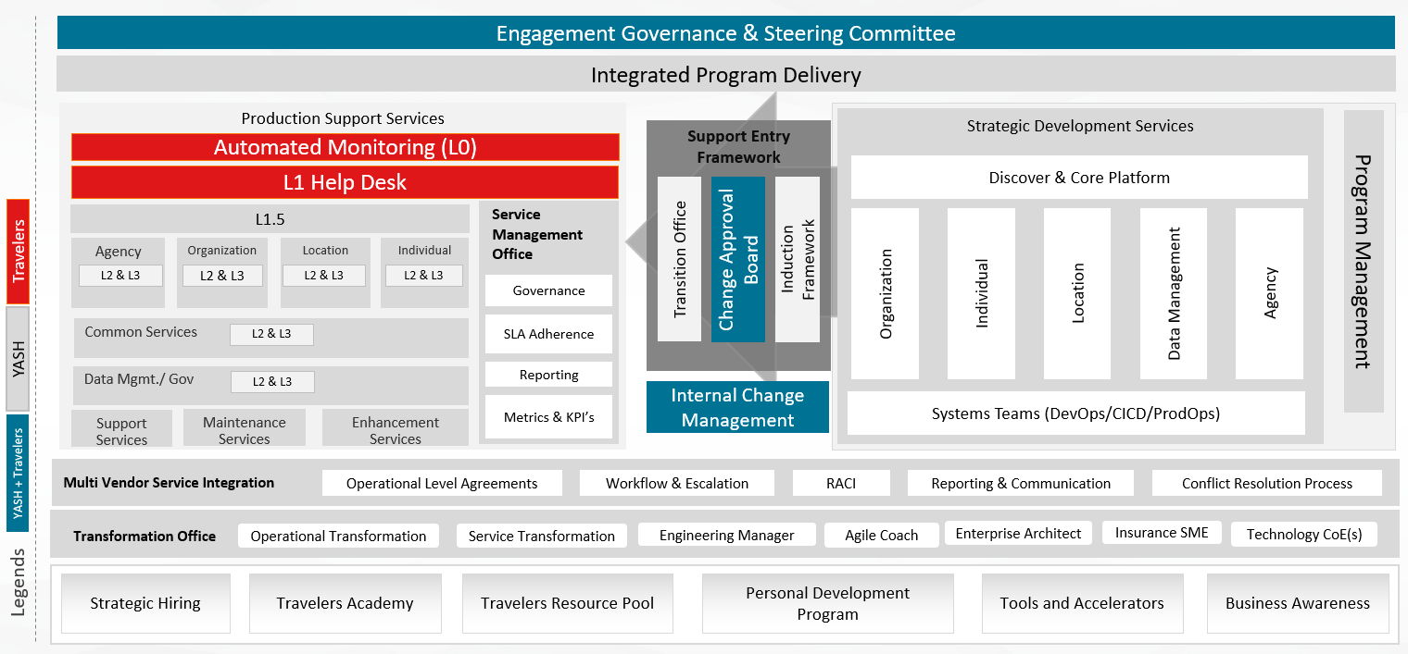
Travelers Integrated Delivery Model
2
3
Support Entry Framework for seamless transition from strategic development and production support teams
4
Service Management Office and Engagement Governance ensuring measurable services driving service maturity
4
2
2
1
Production support services following Travelers processes and standards
1
Strategic development services organized based on domain PODs / Houses, following Travelers processes and standards
3
4
5
Framework for Travelers and YASH resources to work as ‘One Team’
5
6
6
Transformation Office tasked with driving operational and technical transformation
9
7
8
7
8
9
Strategic hiring and proactive resource pool development
Travelers Academy that undergirds the resource training resource readiness, upskilling, cross skilling and creating business awareness
Make Travelers a stakeholder in the personal development of each YASH resource assigned to Travelers

Slide 3
Demonstration of governance structure and client care organization
3
Engagement Governance & Steering Committee
Engagement Governance & Steering Committee
Integrated Program Delivery
Integrated Program Delivery
Data Center/Cloud Management
Demand Management
Support Entry Framework
Strategic Development Services
Support Entry Framework
New Projects (Invest)
Business Continuity
Security
Discover & Core Platform
Fault Tolerant and Disaster Recovery.
System Migration (Migrate)
Governance
Organization
Individual
Location
Data Management
Agency
Change Approval Board
Change Approval Board
Transition Office
Transition Office
Induction Framework
Induction Framework
Program Management
Major Enhancements (Tolerate)
Backup & Restore
Risk
System Retirement (Eliminate)
Replication
Compliance
Cloud Adaption
Internal Change Management
Internal Change Management
Systems Teams (DevOps/CICD/ProdOps)
Multi Vendor Service Integration
Multi Vendor Service Integration
Operational Level Agreements
Workflow & Escalation
RACI
Reporting & Communication
Conflict Resolution Process
Operational Level Agreements
Workflow & Escalation
RACI
Reporting & Communication
Conflict Resolution Process
Agile CoE
DevOps CoE
OCM
Technology CoE(s)
Transformation Office
Enterprise Architect
Transformation Office
Engineering Manager
Agile Coach
Mining SME
Operational Transformation
Service Transformation
Strategic Hiring
CAT Academy
CAT Resource Pool
Personal Development Program
Tools and Accelerators
Business Awareness
Knowledge Hub
Tools and Accelerators
S&N Academy
Integrated Support Hub
Delivery
Enablers and BOTs
360 degree Delivery Insights

Slide 4
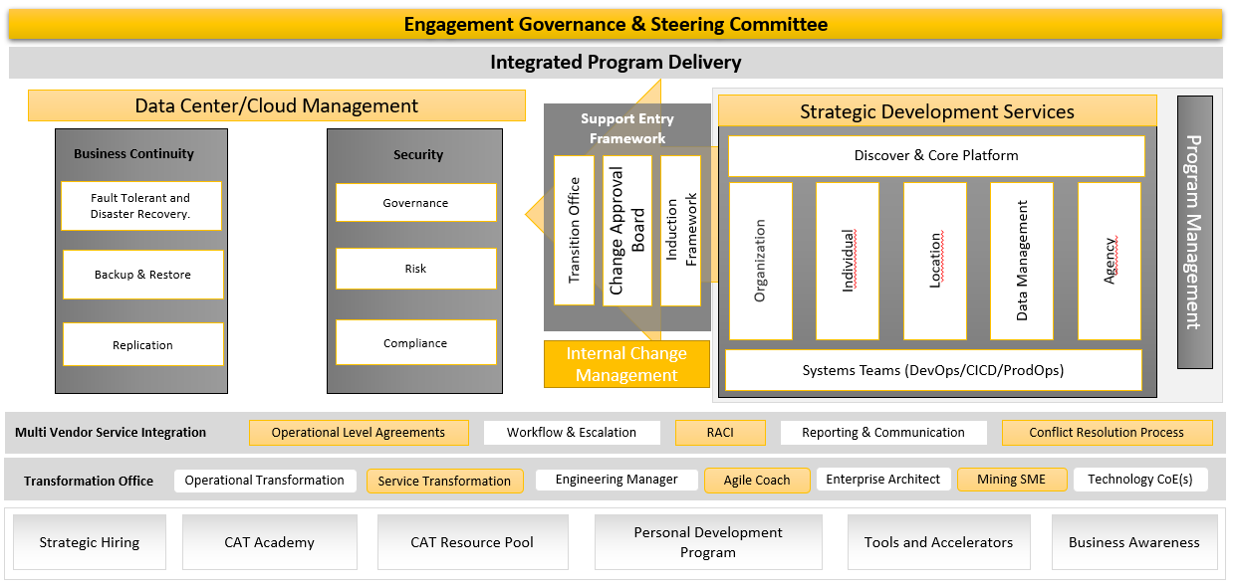
CAT Integrated Delivery Model
3
Support Entry Framework for seamless transition from strategic development and production support teams
4
Security Management services ensure the governance, and risk with proper solution ensuring service maturity.
2
Data Center/Cloud Management includes Business Continuity and Security using Cloud or other services following CAT processes and standards.
2
3
1
1
4
Strategic development services organized based on domain PODs / Houses, following Travelers processes and standards
5
Framework for CAT and YASH resources to work as ‘One Team’
5
6
6
Transformation Office tasked with driving operational and technical transformation
7
8
9
7
8
Strategic hiring and proactive resource pool development
CAT Academy that undergirds the resource training resource readiness, upskilling, cross skilling and creating business awareness
9
Make CAT a stakeholder in the personal development of each YASH resource assigned to CAT Project.

